Slide 1
Electrical Submittal
Plan review

Slide 2

When is an Electrical Permit Required?

Slide 3

Yes.

Slide 4
Exceptions to Electrical Permits
Replacing Switches and Receptacles Only
Like for Like direct swaps of single device(Light switch or 120V receptacle)
Like for like Breaker swap

Slide 5
Panel Calculation
(NEC 220)
When Needed
  New load added to existing circuit(circuit extension)
  New load added to existing panel
When NOT Needed
  Decrease in load(Lights converting to LED, etc.)
  Like for Like replacements(Provide existing and new ratings to show no increase)

Slide 6
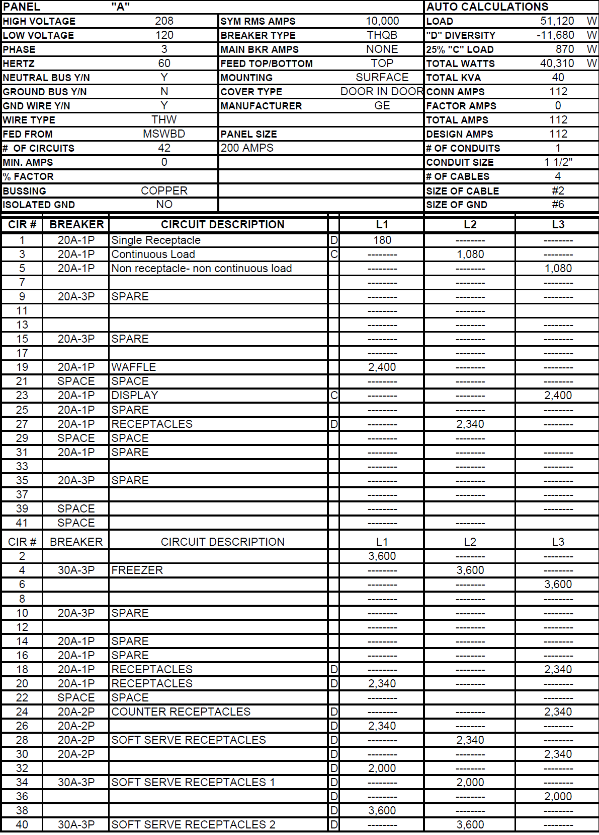
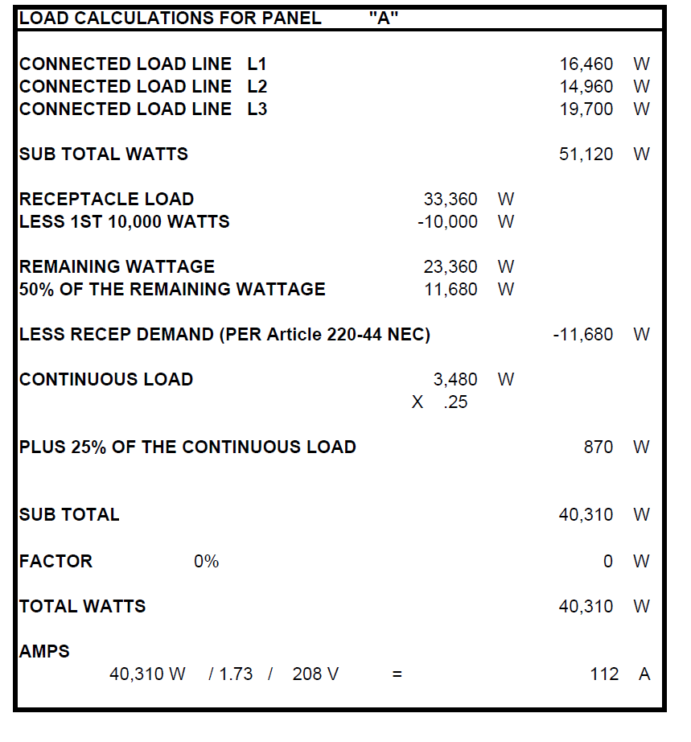
Panel Calculation Form
Where to Find
https://fp.ucf.edu/resources/electrical-panel-forms/

Slide 7
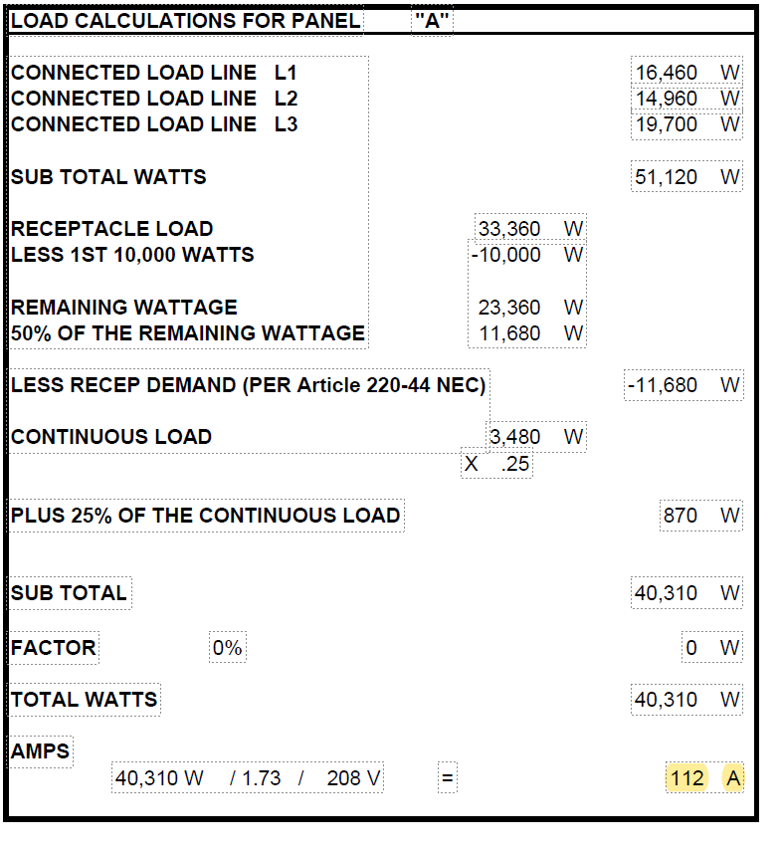
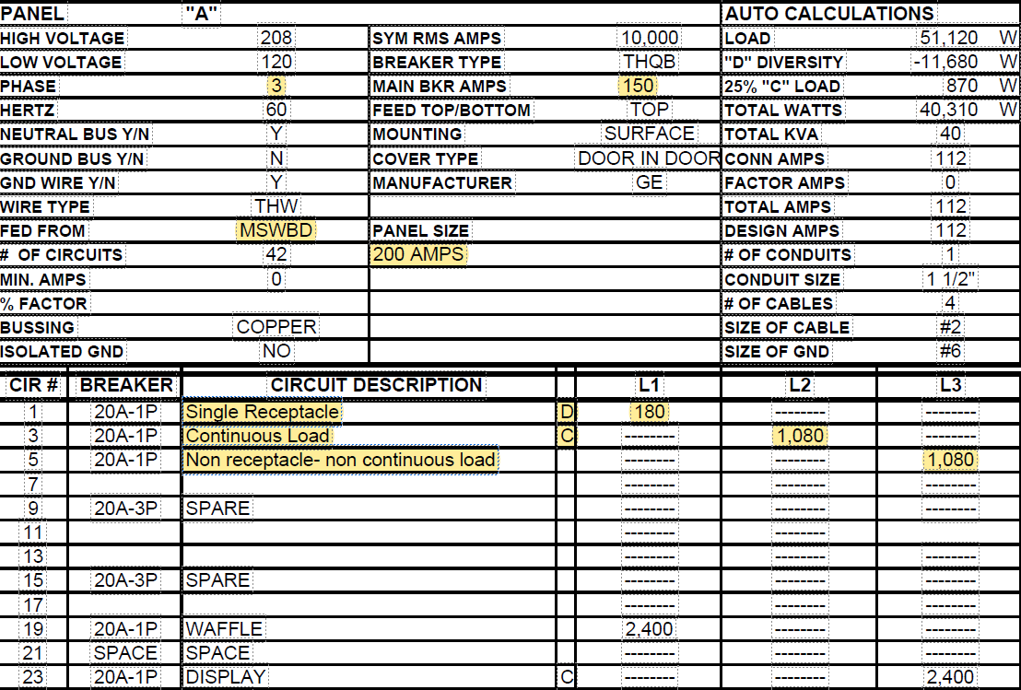
Panel Calc Info Example
Load
OCPD/PANEL/Circuits

Slide 8
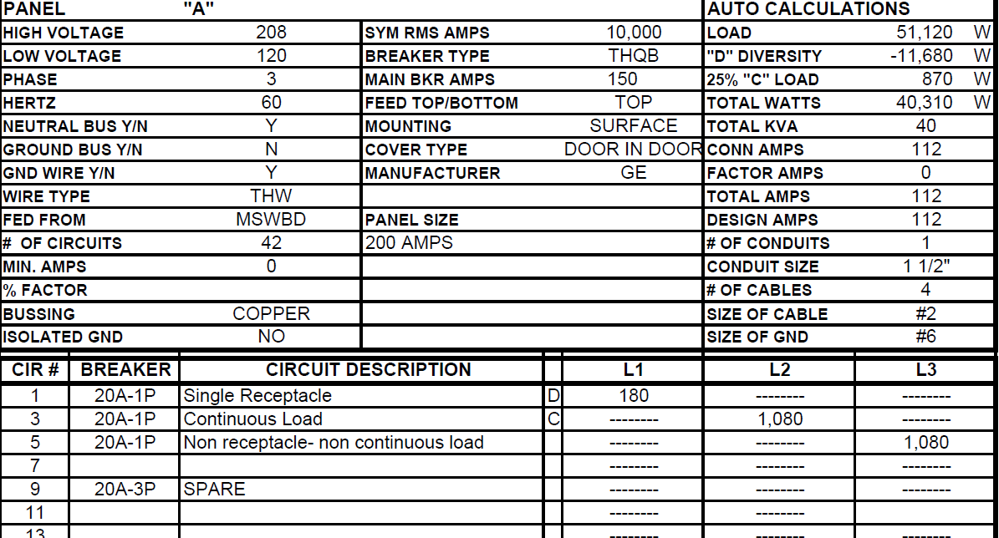
Panel Calc Required Information
Main Breaker Rating(NEC 408.30 & 408.36)
  Breaker protecting/feeding panel
Panel Size(NEC 408)
  Rating of panel in amps
Fed From
  Location of main breaker
Circuit Description
Load rating (NEC 220)
  How much power the circuit will draw represented in VA(Volt-Amperes)
Circuit Designation
  “D” for receptacle loads calculated in accordance with NEC 220.14(H) FIXED MULTIOUTLET ASSEMBLIES or NEC 220.14(I)Receptacle Outlets only
  “C” for continuous loads
  “ “ Leave blank for loads not considered continuous and not receptacles and for specific loads/appliances.
  Highlight circuit where load is to be added

Slide 9
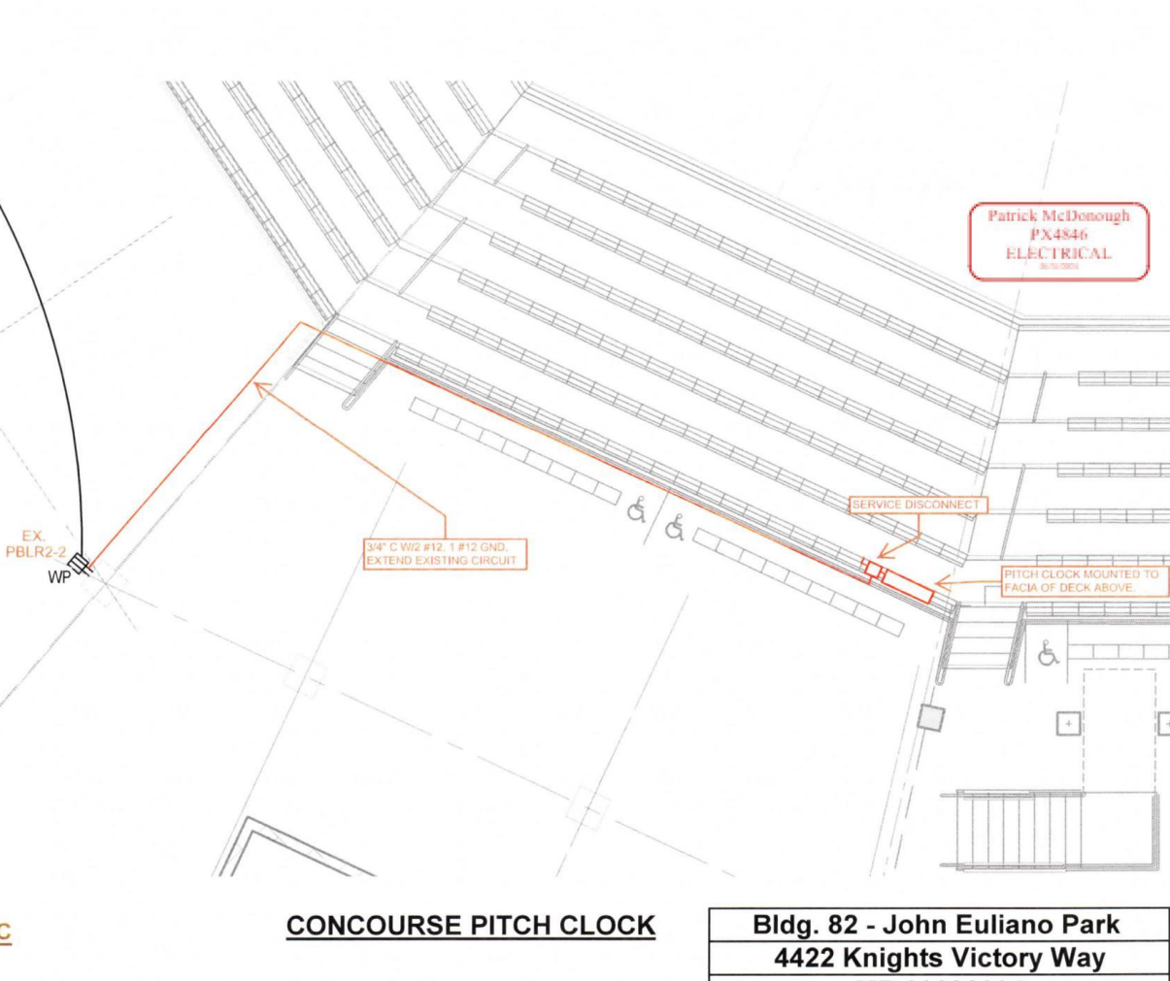
Methods and Materials
(NEC 300 & 400)
How will the scope of work be done?
Can be shown on site plan
Locations of where work occurs
What materials are being used to complete the job?
Description of type/number of/ size of material to be used
Is all the equipment and materials listed for the proposed scope of work? (NEC 110.3(C))
Providing equipment specs showing listing agency approval

Slide 10
Things to Consider
Wire size/Ampacity
Conduit size/fill
Panel and Breaker Size
Wire sizes and their allowable ampacities can be found in the NEC Table 310.16 for raceways with NOT MORE THAN 3 current carrying conductors.
If raceway has MORE THAN 3 current carrying conductors apply the adjustment factors found in NEC Table 310.15(C)(1)
Wires must be protected by overcurrent device not exceeding its allowable ampacity(NEC 240.4)
NEC Chapter 9
Over 2 conductors, conduits can use UP TO 40% cross sectional area of conduit
Grounding conductor shall be counted
NEC 408.30/NEC 240.4
The panel board must have a rating GREATER than the load
The OCPD(Main Breaker) must be GREATER than load but LOWER OR EQUAL TO the panel rating
The load can NOT be greater than rating of the panel and main breaker

Slide 11
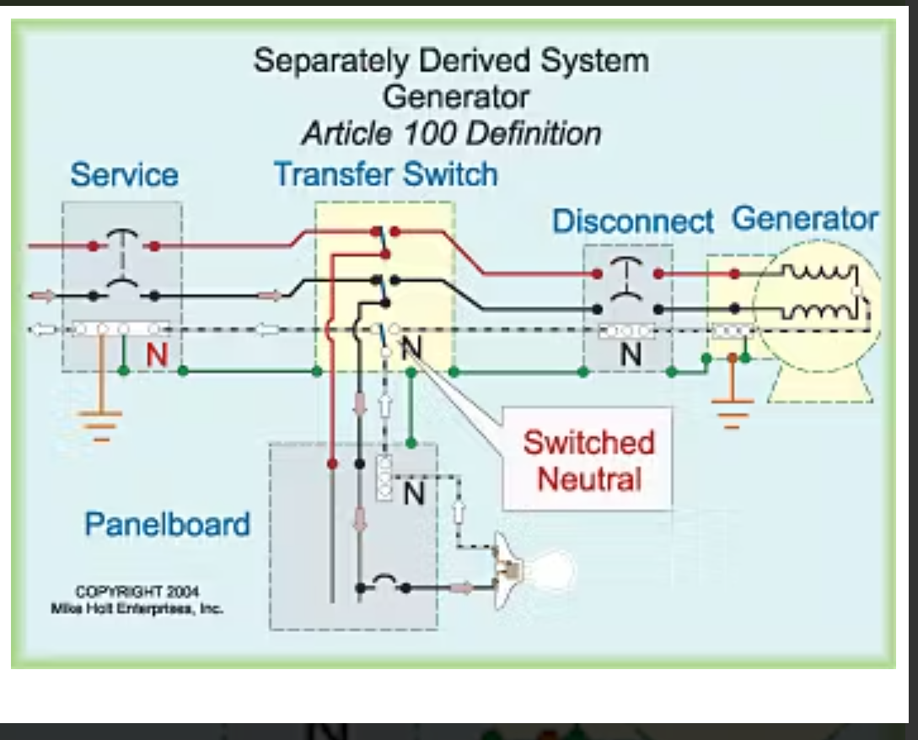
Automatic Transfer Switches(ATS) and Separately Derived Systems(SDS)
Replacing or installing a new or existing transformer/generator/ATS
GENERATORS ARE ONLY CONSIDERED SDS WHEN SWITCHING THE NEUTRAL AT THE ATS
The contractor or EOR must provide a grounding detail showing existing grounding conditions as well as intended grounding and bonding connections for the new work.
These details should include the location of the main bonding jumper(if applicable) and the size of the MBJ as well as the size of the ungrounded conductors.

