Slide 1

Permitting In Citizenserve https://www.citizenserve.com
https://www.buildingdepartment.fs.ucf.edu

Slide 2
Navigating the Permitting Process with Citizenserve
Process Overview
Register and Create an Account
Application Completion
Add Contractor/Subcontractor/Architect/Engineer/UCF PM
Submittals (Supporting Documents)
Plans Review
Permit Issuance
Inspections
CC/CO (Certificate of Completion/Certificate of Occupancy)

Slide 3
How to Register in Citizenserve
Visit our Building Department Website: https://www.buildingdepartment.fs.ucf.edu/
  Select “Citizenserve Permitting Software”
  Navigate to the portal using http://www.citizenserve.com/ucf
Go to “My Account” and select “Register Now”.
Choose the corresponding registration type.
  Contractor, Project Manager, Architect/Engineer, etc.
  Use Email as Username for ease of access.
The account must have valid contact, license, insurance and Certificate of Insurance (COI) information if applicable to account type.
Any Contractors Listed on the Application must have a FL License.
  You May Verify the License via the link https://www2.myfloridalicense.com/
Notes:
If you found out that you or your subcontractor might have more than one account, please let us know so we can delete the one that you don’t need to avoid confusion.
If those involved in the project do not have an account with Citizenserve, please have them create a new account. Do not select "Enter a new contact" as this will create an account on their behalf and they will not be able to access it for changes if needed.

Slide 4
Application Roles and Requirements
Applicant: Has full access to the permit and is the only person able to edit application, upload files, etc.
UCF Project Manager: Enters worktags, confirms scope of work and total value of work, identifies ITAR spaces, laboratories needing EH&S review, low voltage and payment/performance bond requirements.
Contractors: License and insurance requirement, submittals, inspections, CC/CO requests. For the initial prompts regarding ITAR labs, EH&S review, Payment/Bond, and Low Voltage, please reach out to your UCF project manager for more information.
Additional Resources On Our Website:
  Permit fee calculator, Citizenserve instructional guides, our permitting procedures, and more.
Notes:
Permit fee calculator
Permitting procedures

Slide 5
License and COI (Certificate of Insurance)
License, Insurance, and COI Expiration dates must be up to date
  Certified vs Registered License Holders
    A competency card for Orange County must be provided for “Registered” license type or provide evidence of license that has been State Certified by DPBR.
The Certificate Holder on each COI provided MUST be the University.
Please use the standard holder’s address below:
    University of Central Florida Board of Trustees
    ATTN: Risk Management
    4365 Andromeda Loop N. MH 328
    Orlando, FL 32816-0001
For COI updates, the account user may use the link "update my information" after login and delete the old one before uploading the new one. Select “Submit” once completed.
Please note that we are unable to edit the documents attached to the Citizenserve accounts. The account holder would need to upload this document into their Citizenserve account. This way, the COI also stays attached to their account for future projects.
Notes:
Workman’s Compensation should be covered by COI, or an exemption form should be submitted. https://www.myfloridacfo.com/division/wc/employer/exemptions

Slide 6
Application Requirement and Resources
Electronic plans must be in PDF format.
Acceptable in JPG (Photos).
NO Zip File, Portfolio (Combined PDF File) – Cannot be opened and stamped.
State Fire Marshal (SFM): When applicable, we will submit any required drawings to the State Fire Marshal for Fire Code plans review on your behalf.
An SFM application is required for each review submittal per SFM.
SFM has a minimum 30 day review window.
  Where to Find It?
    Go to Building Department Website and Click the Link “State Fire Marshall’s Office”
    Click on “Plans Review” ➜ “Submit Paper Plans for Review” ➜“Paper Plans Review Application”

Slide 7
Low Voltage Permitting
When applying for a permit, the applicant will be prompted with the following question and answer options:
Will Low Voltage work be covered under this permit or under an IT Permit?
  IT permit will cover low voltage work.
  Not Applicable - No low voltage work is associated.
  This permit covers low voltage work.
If Option 1 is selected, an IT permit will be needed for the associated work, and a pass-final inspection will not occur until the IT permit information has been provided. A final pass inspection will be needed for associated permits prior to CC requests.
If Option 3 is selected, we will verify that a licensed LV subcontractor is listed on the permit and ask them to confirm that they will be responsible for the LV prior to moving forward.

Slide 8
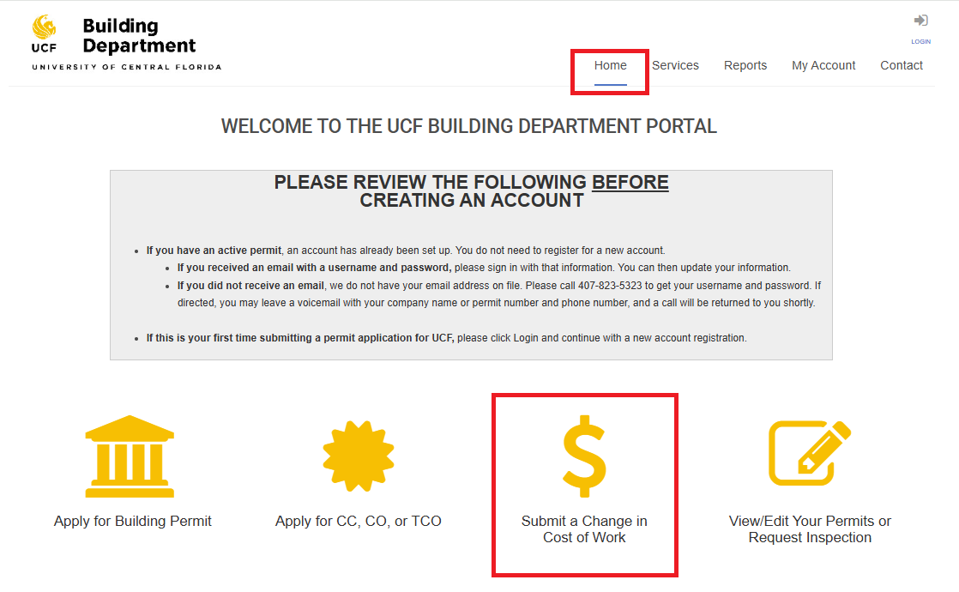
Cost of Work Change
If the cost of work listed in the permit application is incorrect, please submit a Change in Cost of Work using the corresponding icon located in Citizenserve under “Home” or “My Account”.
Cost of Work includes total value of the work covered by the permit, including design, materials, equipment and labor. This also includes the fees charged by UCF IT, if applicable.

Slide 9
Payment of Permit Fees
Permit fees must be paid by Work Tags, applicants may pay by check made payable to The University of Central Florida, under special circumstances, with prior approval from the Building Official.
Temporary Certificate of Occupancy (TCO) fees must be paid by check by the contractor, or a specific request to pay by Work Tags must be submitted by the UCF entity responsible for the work, to the building official (portfolio manager or director, and above).
After-Hours Inspection fee’s must be paid by check, by the contractor, or a specific request to pay by Work Tags must be submitted, by the UCF entity responsible for the work, to the building official (portfolio manager or director, and above)
Permit Issuance: We will proceed with the permit issuance process when there are no outstanding fees or conditions, plans are approved by BCO and SFM if applicable, license and COI are up to date for all contractors.

Slide 10
Plans Review Timeframes – Per Submission
Under $2 Million in Project Cost: 7 Working Days
Over $2 Million to $8 Million in Project Cost: 15 Working Days
Over $ 8 Million in Project Cost: 20 Working Days
State Fire Marshal (SFM): Minimum 30 Days
Expedite Plan Review Fee Option Available for $550.00 Per Review
SFM Expedite Not Available
Notes:
Expedite plans review fee option, see permit procedures
SFM expedite not available.

Slide 11
Inspections
See Permitting Procedures for More detail
Regular Time of Inspections: 8:00am – 4:00pm, Request 48 Hours in Advance.
After Hours Inspection: $300.00 ($150 Per Hour, 2 Hours Minimum)
The Same Day Inspection: $150.00
Inspection Cancellation: Inspections can be cancelled through Citizenserve. We kindly ask that you notify your assigned inspector or our office to ensure proper communication.
  Inspections cancelled after 4 p.m. the business day prior to the inspection day will be subject to a re-inspection fee.
Reinspection Fee: $150.00 can be paid by check, no cash and credit card payments accepted.
  No further inspection until any outstanding fees paid in full.
SFM Inspection: Send the Inspection Request Form to your designated SFM inspector.
  SFM Invoices: To be paid directly to the Tallahassee office.
Check Payment: Pay Checks to UCF or UCF Building Department.
Mail Checks To:
UCF Building Department
PO Box 163499
Orlando, FL 32816-3499
Notes:
Deliver check to office physical address
No online payment available

Slide 12
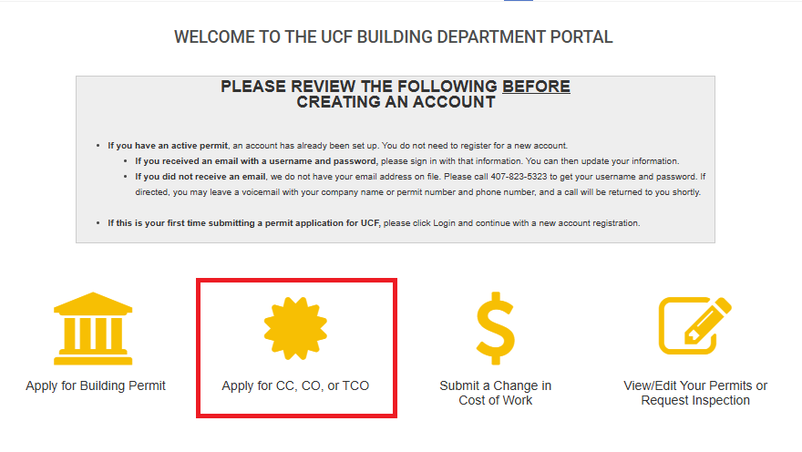
Must Close Out Permit - CC/CO Request
Please keep permit active to avoid being revoked.
Permits will be expired after 180 days without any valid activities.
If needed, request a permit extension by emailing a memo with justifiable cause to Building Official.
Permit applicants are responsible for closing permits by submitting CC/CO Requests
    How to Apply for and Obtain a CO or CC via Citizenserve
  All Required Inspections Must be Passed
  No Pending Conditions
  Associated Permits are to be Closed in Conjunction of Each Other
  Receive the Certificate of Completion/Occupancy
Notes:
Example: Updating information on the application or cancelled inspection are not valid activities

Slide 13
Building Department Team https://www.buildingdepartment.fs.ucf.edu
Roy Johnston
Building Code Official
Roy.Johnston@ucf.edu
407-823-0423
Patrick McDonough
Electrical Plans Examiner/Inspector II
Patrick.McDonough@ucf.edu
407-823-4173
Alba Valencia
Building Plans
Examiner/Inspector I
Alba.Valencia@ucf.edu
407-823-0111
Jim Washington
Mechanical/Plumbing Plans
Examiner/Inspector I
James.washington@ucf.edu
407-823-0411
Ning Li
Administrative Assistant III
Permit Technician
Ning.Li@ucf.edu
407-823-5323
Byron Cordova
Administrative Assistant II
Permit Technician
Byron.Cordova@ucf.edu
407-823-0096

